Slide 1
AI Lecture 13: MDPs and Linear Programming

Slide 2
Linear Programming
Mathematical programming is used to find the best or optimal solution to a problem that requires a decision or set of decisions about how best to use a set of limited resources to achieve a state goal of objectives.
Steps involved in mathematical programming
Conversion of stated problem into a mathematical model that abstracts all the essential elements of the problem.
Exploration of different solutions of the problem.
Finding out the most suitable or optimum solution.
Linear programming requires that all the mathematical functions in the model be linear functions.

Slide 3
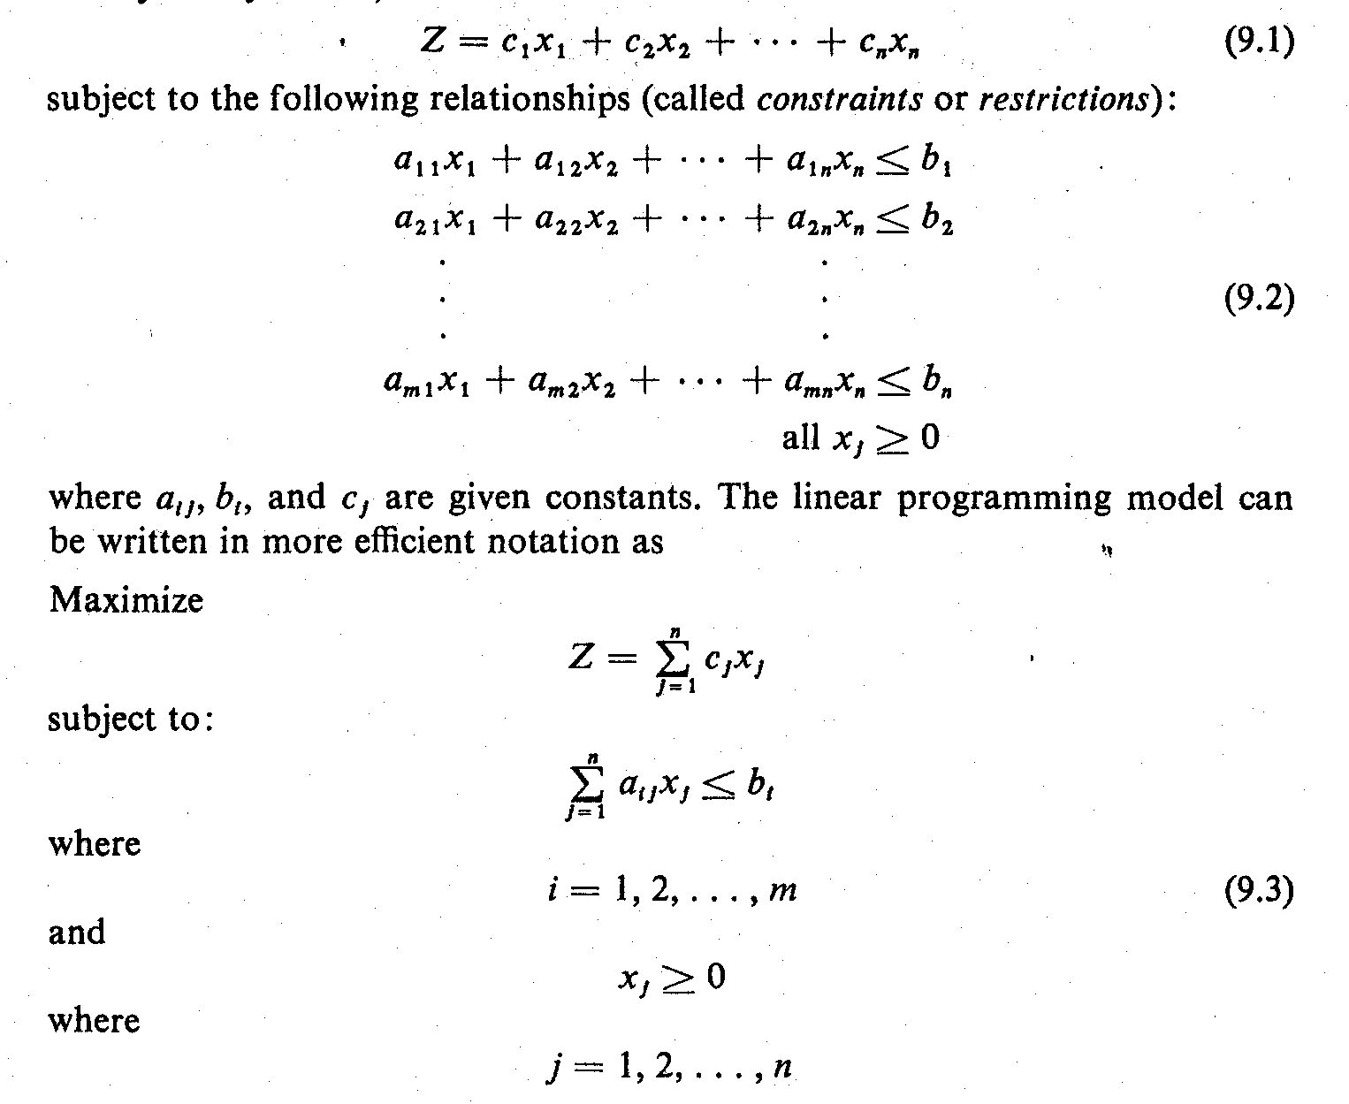
The Linear Programming Model (1)
Let: X₁, X₂, X₃, ………, X_{n} = decision variables
Z = Objective function or linear function
Requirement: Maximization of the linear function Z.
Z = c₁X₁ + c₂X₂ + c₃X₃ + ………+ c_{n}X_{n} …..Eq (1)
subject to the following constraints:
…..Eq (2)
where a_{ij}, b_{i}, and c_{j} are given constants.

Slide 4
The Linear Programming Model (2)
The linear programming model can be written in more efficient notation as:
…..Eq (3)
The decision variables, x_{I}, x₂, ..., x_{n}, represent levels of n competing activities.

Slide 5
Examples of LP Problems (1)
1. A Product Mix Problem
A manufacturer has fixed amounts of different resources such as raw material, labor, and equipment.
These resources can be combined to produce any one of several different products.
The quantity of the i^{th} resource required to produce one unit of the j^{th} product is known.
The decision maker wishes to produce the combination of products that will maximize total income.

Slide 6
Examples of LP Problems (2)
2. A Transportation Problem
A product is to be shipped in the amounts a_{l}, a₂, ..., a_{m} from m shipping origins and received in amounts b_{l}, b₂, ..., b_{n} at each of n shipping destinations.
The cost of shipping a unit from the i^{th} origin to the j^{th} destination is known for all combinations of origins and destinations.
The problem is to determine the amount to be shipped from each origin to each destination such that the total cost of transportation is a minimum.

Slide 7
Examples of LP Problems (3)
3. A Flow Capacity Problem
One or more commodities (e.g., traffic, water, information, cash, etc.) are flowing from one point to another through a network whose branches have various constraints and flow capacities.
The direction of flow in each branch and the capacity of each branch are known.
The problem is to determine the maximum flow, or capacity of the network.

Slide 8
Developing LP Model
Consider the product mix problem
Steps Involved:
Determine the objective of the problem and describe it by a criterion function in terms of the decision variables.
Find out the constraints.
Do the analysis which should lead to the selection of values for the decision variables that optimize the criterion function while satisfying all the constraints imposed on the problem.

Slide 9
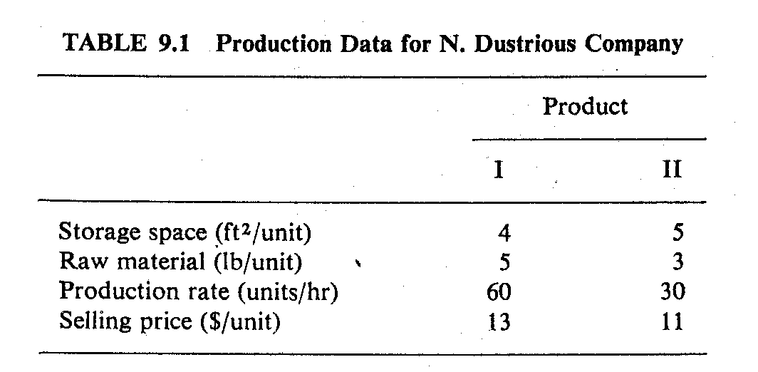
Developing LP Model
XYZ Company produces two products: I and II. The raw material requirements, space needed for storage, production rates, and selling prices for these products are given in Table 1.
The total amount of raw material available per day for both products is 15751b. The total storage space for all products is 1500 ft², and a maximum of 7 hours per day can be used for production.

Slide 10
Developing LP Model
All products manufactured are shipped out of the storage area at the end of the day. Therefore, the two products must share the total raw material, storage space, and production time. The company wants to determine how many units of each product to produce per day to maximize its total income.
Solution
The company has decided that it wants to maximize its sale income, which depends on the number of units of product I and II that it produces.
Therefore, the decision variables, x₁ and x₂ can be the number of units of products I and II, respectively, produced per day.

Slide 11
Developing LP Model
The object is to maximize the equation:
Z = 13x₁ + 11x₂
subject to the constraints on storage space, raw materials, and production time.
Each unit of product I requires 4 ft² of storage space and each unit of product II requires 5 ft². Thus a total of 4x₁ + 5x₂ ft² of storage space is needed each day. This space must be less than or equal to the available storage space, which is 1500 ft². Therefore,
4X₁ + 5X₂ ≤ 1500
Similarly, each unit of product I and II produced requires 5 and 3 lbs, respectively, of raw material. Hence a total of 5x_{l} + 3x₂ Ib of raw material is used.

Slide 12
Developing LP Model
This must be less than or equal to the total amount of raw material available, which is 1575 Ib. Therefore,
5x₁ + 3x₂ ≤ 1575
Product I can be produced at the rate of 60 units per hour. Therefore, it must take 1/60 of an hour to produce 1 unit. Similarly, it requires 1/30 of an hour to produce 1 unit of product II. Hence a total of x₁/60 + x₂/30 hours is required for the daily production. This quantity must be less than or equal to the total production time available each day. Therefore,
x₁ / 60 + x₂ / 30 ≤ 7 or x₁ + 2x₂ ≤ 420
Finally, the company cannot produce a negative quantity of any product, therefore x₁ and x₂ must each be greater than or equal to zero.

Slide 13
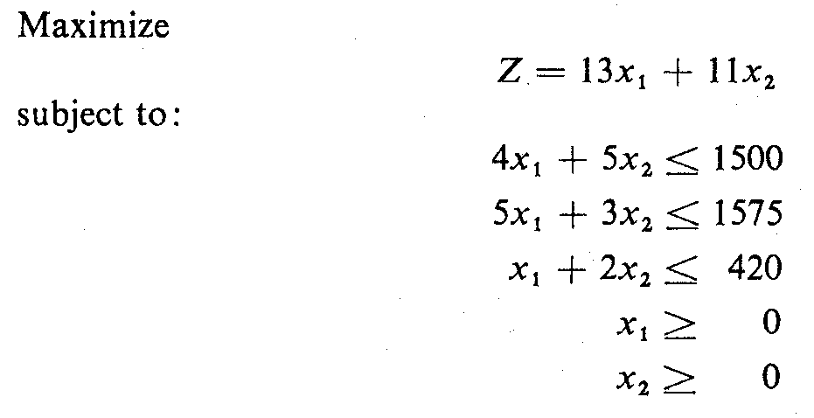
Developing LP Model
The linear programming model for this example can be summarized as:

Slide 14
Linear Programming for MDPs
Maximize
Σ V_{j} (S is the set of states, Vj is cost of state)
j∈S
Constraint:
V_{i} <= [ R(I,A) + γ Σ P(J|I,A)* V_{j}]

Slide 15
Linear Programming
Linear programming polynomial time (Karmarkar, 84)
Popular method Dantzig’s simplex (1963)
Simplex performs well in practice, but could be exponential
Although polynomial time typically slower than MDP specific algorithms such as value iteration
Determine policy from V_{i} using method from previous slides
Yields a deterministic policy for MDPs: why?
Key advantage: Many times it is amenable to modeling specific constraints

Slide 16
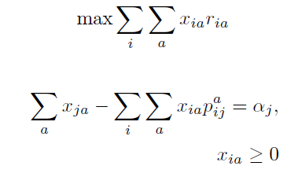
A more popular formulation
x_{ia}: Expected number of times action a is taken in state i
r_{ia}: Reward for taking action a in state i
p^a_{ij}: Probability of reaching state j when action a is taken in state I
α_{j}: Initial probability of being in state j

Slide 17
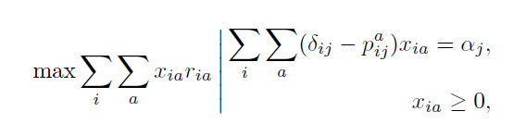
Refactoring

Slide 18
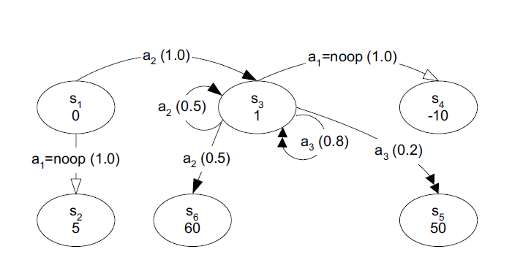
MDP Example

Slide 19

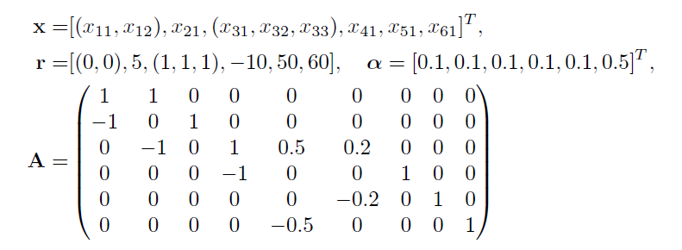
MDP Example

Slide 20

Solution to the LP
Solving the LP we get x, which maps to a deterministic uniformly-optimal policy
We get the following output if we change alpha to the following

Slide 21
CMDP
A key advantage of the formulation is the ability to model constraints
If we want to say state 1 must have all actions take with equal probability
x11 = x12
Addition of such constraints results in a CMDP (Constrained MDP)
How do you model action 1 in state 1 must be taken 30% of time ?
X11/(x11+x12) = 1/3
How can you do this with value or policy iteration ?

Slide 22
Multi-Agent MDP (MMDP)
MMDP: A direct extension over MDPs for multiple agents
M = <S, {A_{i}}_{i∈m}, T, R>
S is set of possible world states
{A_{i}}_{i∈m} is set of joint actions, <a₁, …, a_{m}> where a_{i} ∈ A_{i}
T defines transition probabilities over joint actions
R is team reward function
State is fully observable by each agent
In absence of communication, random policies can lead to mis-coordination
Ex: In state s, policy a1b2 = .7 and a2b1 = .3 would lead to a1b1 with .21, a1b2 with .49, a2b1 with .09 and a2b2 with .21

Slide 23
Dec-MDP
In MMDP model agent observes the joint state
Many times in a joint problem, an agent may observe only his/her local state
Separating out the policy computation for each agent is not an option since they have joint transitions and rewards
Dec-MDP – A formal framework to address these issues

Slide 24
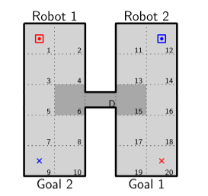
Robots coordinating in a hallway with a narrow passage
Can be modeled using Dec-MDP framework

